Slide 1
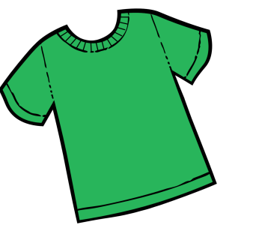
T-SHIRT DESIGN
Contest
Win a $200 gift card to Staples and receive a free shirt with your winning design!
Your Design Must:
-include the words ”2025 Northern BC Regional Science Fair”
-have no more than 3 colors (black not included)
-be no larger than 8.5”x11”
-include your name, age, grade, school, and home phone number on the back
Deadline for submissions is Fri Feb 14, 2025. Please email to: Events.nbcrsf@gmail.com

