Slide 1

Southeast
Saskatchewan
Regional Science Fairs

Slide 2
Science Fair STEAM Fair
Why do we call our Science Fair a STEAM Fair instead?
STEAM is a more inclusive idea that recognizes the many different disciplines it includes. Science is still there – it is the “S” in STEAM. So what are the other disciplines involved?
T = Technology
E = Engineering
A = Art
M = Math
Why Art? Without art (like models, diagrams, designs, figures, animations, etc) it would be quite difficult to understand a scientific concept.

Slide 3
Why do a STEAM Fair Project?
STEAM Fair Projects allow for:
Learning: STEAM Fair Projects let students apply their knowledge to real-world situations allowing for a better understanding of scientific principles.
Critical thinking and problem-solving abilities.
Collaboration: Students work together and communicate effectively to reach a shared goal.
Creativity: Students are encouraged and allowed to be creative and innovative.
Confidence building.
Students to meet others with similar interests.
Potential prizes and scholarships.
Post-secondary applications: Involvement can help a student stand out.
Personal connections: Students can select a topic of their choice in an area of personal interest which leads to greater ownership of the project

Slide 4
How Do You Start?
First and foremost, a problem or question must arise from observations about the world around you.
Then What?
The Four Stages of Problem Solving:
Become aware of a problem and formulate a testable question that can be investigated.
Pick a project type: Experiment; Study; or Innovation.
Conduct the investigation/design and build an innovation, and collect information.
Analyze the information and interpret the results. Communicate the results to others.

Slide 5
Step One – Individual or Partner Project
Projects can be done on your own or with a partner. Groups may not have more than two people per project.
Participants must be in grades 5 -12 to participate in the Regional STEAM Fair. However, in order for a project to qualify for the Canada Wide Science Fair, the individual or partners must be in grades 7-12.
Students from different grades can be partners, however, the project will have to be registered in the category for the older partner.
Categories:
Primary = Grades 5 and 6
Junior = Grades 7 and 8
Intermediate = Grades 9 and 10
Senior = Grades 11 and 12

Slide 6
Step Two: Pick a Topic
Topics usually come from questions of how, why, or what about natural phenomena.
Keep the project simple. The idea doesn’t have to complicated or super advanced. Some really good projects have been quite simple, but were supported by thorough testing and analysis.
Think about what interests you. Usually when you do a project that interests you or that you care about, you do a better job of carrying out your project.
Ask your family for inspiration.
Look at some science fair project ideas from websites like Science Buddies for inspiration, but not to take ideas directly from the sites (usually these have been done a lot and they are more like a recipe where nothing new is found out from simply copying the idea).
You need to find an activity that is subject and age appropriate.

Slide 7
Projects to Avoid:
Product testing that asks “What is Best?” – comparisons are complicated, especially if there are a ton of brands of a product.
Projects that have already been before and been done a lot – we want STEAM projects to be creative and innovative. However, if you are testing it in a brand new way, then this can be acceptable.
Projects where you already know the results.
Projects that are hard to measure.
Projects that cause risk or pain – however, if you do an acceptable project involving animals or humans, there are ethical forms that need to be filled out.
Projects that are expensive to carry out – you should not have to spend much or any money to do a project.
Projects where the results cannot be repeated.

Slide 8
Step Three: Pick a Project Type
There are three main types of projects:
Project Type A: Experiment
Project Type B: Innovation
Project Type C: Study

Slide 9
Project Type A: Experiment
This involves testing a hypothesis (an educated guess). Only one variable is changed while all other variables stay the same.
There will be a control experiment where nothing is changed at all to be used for comparison to the variable experiment.
A variable is a factor that plays a role in the natural phenomena. For example, soil and its minerals and nutrients, water, and sunlight are variables in plant growth. In a control experiment, no variables are altered.
An independent variable is the variable that is changed in the experiment. Using the above example, I decide to change the amount of water each plant gets in the variable experiment to see what happens when a plant is given more or less than recommended.

Slide 10
Project Type A: Experiment Continued
The dependent variable is what is measured or observed due to changing the independent variable (or can be thought of as the result). So, if I changed the amount of water I gave to my plants, I could measure the height of the plants or judge the overall health of the plants using a rating scale.
Verification: in order to trust your results as being accurate, you need to carry out many trials of each independent variable to ensure you get reliable data. So, I would grow 10 plants to receive the recommended amount of water as my control experiment, and for the variable experiment, 10 plants to receive less water and 10 plants to received more water.
See the 4-H Canada Science Fair 2023-24 Handbook https://4-h-canada.ca/programs/4-h-canada-science-fair/science-fair-resources/

Slide 11
Project Type B: Innovation
This involves creating a new product, technique, technology, or scientific method, or modifying any of these that already exist to carry out a new task.
This still needs to be tested to make sure it works under all conditions that it is intended to be used for.
This should have a real-world application (a need for this) with commercial capabilities. A working model or a life-size functional product is preferred.
See the 4-H Canada Science Fair 2023-24 Handbook https://4-h-canada.ca/programs/4-h-canada-science-fair/science-fair-resources/

Slide 12
Project Type C: Study
This involves researching many different sources on a topic, assembling all of the data together (overlaying) from each source to analyze to lead to a new discovery or conclusion.
This requires a lot of research and gaining a deeper understanding of the topics. You will need to synthesize all of the data or facts together and seeing if you are able to draw a new idea out of this process.
This is NOT a book report, or researching an idea and regurgitating the facts back in a paper.
See the 4-H Canada Science Fair 2023-24 Handbook https://4-h-canada.ca/programs/4-h-canada-science-fair/science-fair-resources/

Slide 13
Requirements:
Your project will need to have:
Project Display – see the slides that follow. There is a template for a trifold board with the requirements. If you advance onto the Canada Wide Science Fai, you will need to use a different format that will be found much further down in the slides.
Logbook – this is like a diary of your project. It can be a notebook or a folder. It does not have to look pretty, but it needs to be thorough. This is where you include:
- Research, Jot notes and Brainstorming
- Diagrams and Prototype Designs
- Questions and Hypotheses
- Materials and Procedures
- Observations
- Conclusions
- Challenges
3. Report – see the Template coming up in the slides.

Slide 14
Requirements Continued……..
Citations – You must use APA Style to cite all sources of your information and ideas.
Follow Safety Procedures:
- Chemical Safety and SDS’s
- Fire Safety
- Electrical Safety
- Structural and Mechanical Safety
- Biohazards (this may require an ethics form)
Ethics Forms – if you did any testing on any animals or humans, even a survey, you need to fill out the Ethics forms for this and submit this to your teacher. If there are any questions as to whether something is ethical, there is a form for that.
Ethics in Stem Projects:
https://youthscience.public.doctract.com/doctract/documentportal/08DAEF4FCB7D3B432AB676C340C04CF5?slu=08DCC8711A8F9525EDD246D392A0D819
Request for Advice/Ruling Ethics Committee:
https://youthscience.public.doctract.com/doctract/documentportal/08DAEF4FCB7D3E2646DBD501EF460F34?slu=08DCC870D7C79040732E0452585BEAC4
Safety in Stem Projects:
https://youthscience.public.doctract.com/doctract/documentportal/08DAEF4FCB7D3EA5EA990F677525F38F?slu=08DCC875F6220BADCFB3AEB1852942B2

Slide 15
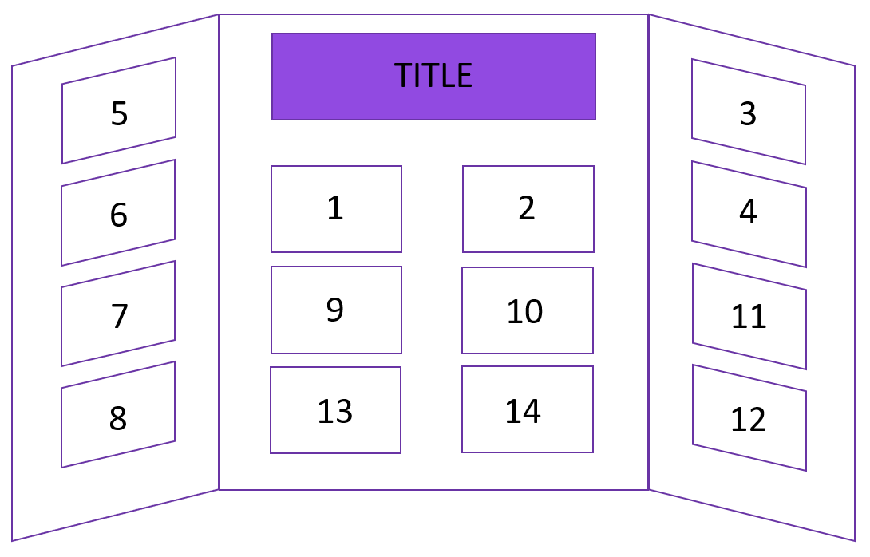
[Delete this slide when you’re finished]
Trifold board are typically 36 inches tall by 48 inches wide, with a 12-inch panel on either side and a 24-inch panel in the middle. You can fit 14 sheets of 8.5”x11” paper on it, plus space for your title.
This is just a suggestion of where things could go – your board doesn’t have to look like this! We strongly recommend making your takeaway statement (1) and hero image (2) big and on the middle panel , but beyond that, it’s up to you! Change the colours/background images of the following slides and make this project your own!

Slide 16
Big takeaway statement (1)
Teach people the main thing you want them to remember from your project in
5 seconds as they walk by.
(This is different than your title.)

Slide 17
Hero image (2)
Use a large image here that captures what you did in your project.

Slide 18

Why? (3)
Tell us your story!
250 words, plus images

Slide 19
Why? (4)
Continue your story

Slide 20
How? (5)
How did you perform your experiment or develop your solution?
300 words, plus images

Slide 21
How? (6)
Continue how you did your experiment or developed your solution.

Slide 22
How? (7)
Continue how you did your experiment or developed your solution.

Slide 23
How? (8)
Continue how you did your experiment or developed your solution.

Slide 24
What? (9)
Tell us your results! What did you find out?
500 words, plus images

Slide 25
What? (10)
Continue to share your results. What did you find out?

Slide 26
So What? (11)
Tell us why your results are important and what they mean.
250 words, plus images

Slide 27
So What? (12)
Continue why your results are important and what they mean.

Slide 28
What’s next? (13)
Tell us how you could extend your project.
100 words, plus images

Slide 29
Thank you and References (13)
Give thanks to people who supported you in your project. Tell us where you got your ideas, information and images.
You can use a very small font on this slide – this information is important, but doesn’t need to take up much room. You could also use this slide for something else, and put your thank you and references along the bottom of your project display.

Slide 30
Judging
Here is the judging form that we use at the Regional Science Fair and it is also used at the Canada Wide Science Fair:
https://youthscience.public.doctract.com/doctract/documentportal/08DB05440A976CFB6C08FFD7F9033488?slu=08DCC874F37A37D9D6B512828A9C1687
We try to invite people that have some to an extensive science background to be our judges, however, we also have some that have very little background as finding judges can be a challenge. We try to match up the level and background of the judges to the level and type of the participants’ projects.
If you know of someone that would be a good fit for judging in the area, please let us know at michael.graham@secpsd.ca.

Slide 31
Registration for the Regional STEAM Fair:
The classroom teacher is to contact Jessica Morland at Jessica.morland@secpsd.ca to get the information for how to register. This way, the committee knows which schools or individual students from a school are planning to attend the regional fair and there are no entries missed due to technical issues.
You may wish to bring your entire number of projects to the fair or you might want to hold a local fair in your school to select just a few projects. We welcome every project to our fair, but we do understand that transportation can be an issue.
Schools or individuals from outside of the Southeast Cornerstone Public School Division are allowed to participate in our fair, there is just a charge of $200 for this.
The expectation is that the classroom teacher is also a judge in the fair.
If you have one entry, that is fine. If they are brought by a parent, we invite the parent to be a judge for the day.

Slide 32
If You Qualify for the CWSF:
You will be initially registered for the CWSF by the SESRSF Committee. You will then get an email to get you started.
There is a different template for the that will be provided if you qualify.

